Slide 1



PET BENEFITS
YOU AND YOUR PETS WILL LOVE
PET ASSURE + PETPLUS
brought to you by Pet Benefit Solutions

Slide 2



YOUR PET BENEFIT OFFERINGS
Discounts on veterinary care
Discounts on pet food,
prescriptions, and more
Maximize your pet care savings by enrolling in both plans!
Pet Benefit Solutions | www.petbenefits.com

Slide 3


WHY PET BENEFITS

Slide 4
PETS ARE FAMILY
Your pets are part of your family, and you’ll do anything to keep them happy and healthy.
45% of pet parents spend as much or more money for their pets' health expenses as their own
65% of pet owners spoil their pets daily, with over half spoiling their pets "24/7"
44% of pet owners celebrate their pet's birthday with a birthday bash
BPM
Zesty Paws
Zesty Paws
Pet Benefit Solutions | www.petbenefits.com

Slide 5


PET CARE COSTS GREW ~70% IN TWO YEARS
$800-$1500
average emergency vet bill
$2000
average spent per pet per year
(not including emergencies)
It's harder than ever to afford quality veterinary care –
with 63% of pet parents not prepared for a
$500 emergency expense
Global market insights from 2020-2022, CNBC
Pet Benefit Solutions | www.petbenefits.com

Slide 6
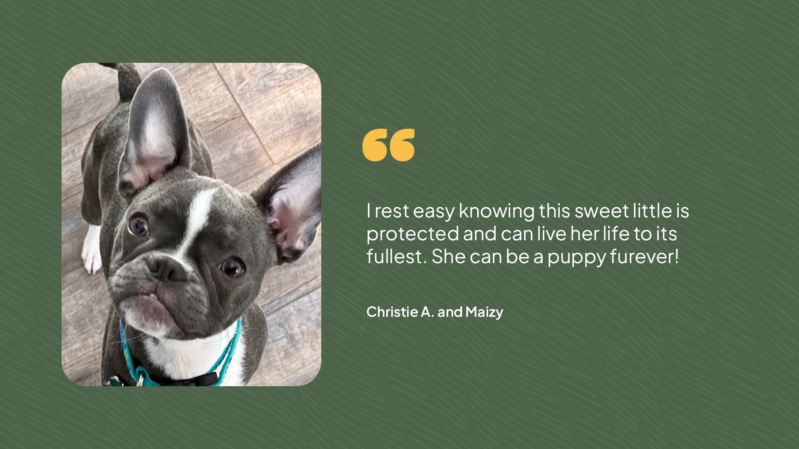
Pet Benefit Solutions | www.petbenefits.com

Slide 7
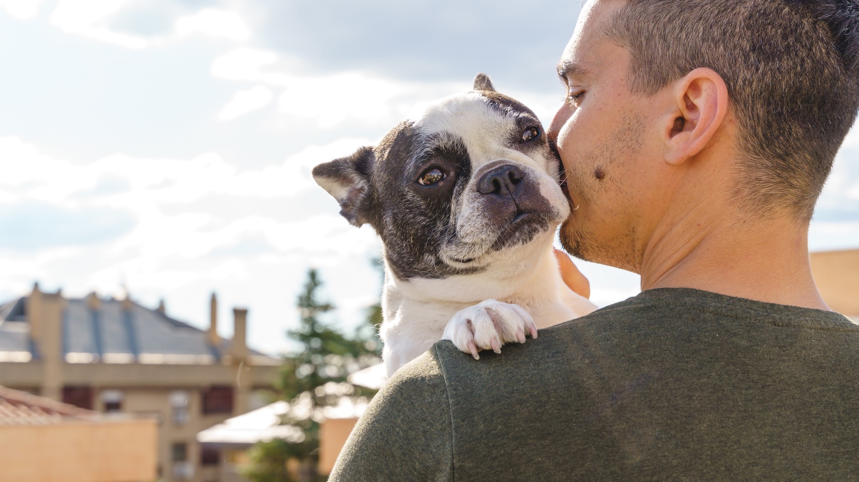
PET ASSURE
Affordable care for every pet family

Slide 8
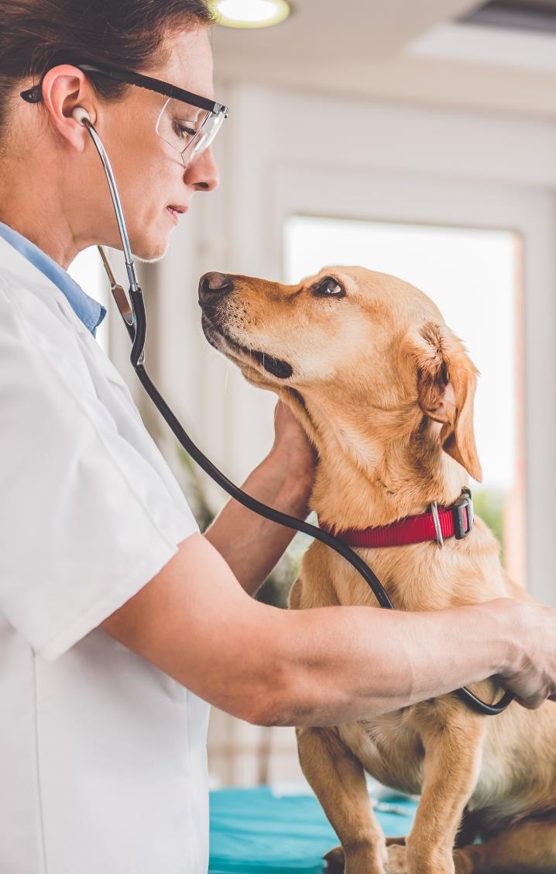

PET ASSURE
VETERINARY DISCOUNT PLAN
PET ASSURE
All pets are eligible, even elderly pets and pets with pre-existing conditions
Participating veterinarians in all 50 states and Puerto Rico
Use as an alternative or addition to pet insurance
Includes 24/7 Lost Pet Recovery Service from ThePetTag

Slide 9

HOW IT WORKS
PET ASSURE
Access your digital ID card through the Pet Assure app
Show your card to any participating veterinarian
Receive an instant 25% discount on all in-house medical services at every appointment
It’s as simple as that!
Pet Assure is not insurance. It’s a discount that your vet gives at the time of service. There are no forms to fill out, no waiting for reimbursements, and no denials of coverage.
Pet Benefit Solutions | www.petbenefits.com

Slide 10


THEPETTAG
LOST PET RECOVERY SERVICE
PET ASSURE
All pets with a collar are eligible to receive an ID tag
If your pet goes missing, the finder scans the tag to access the information you provide in your online profile
No special scanners necessary, just a smartphone
Instantly update contact information online, even after your pet goes missing

Slide 11
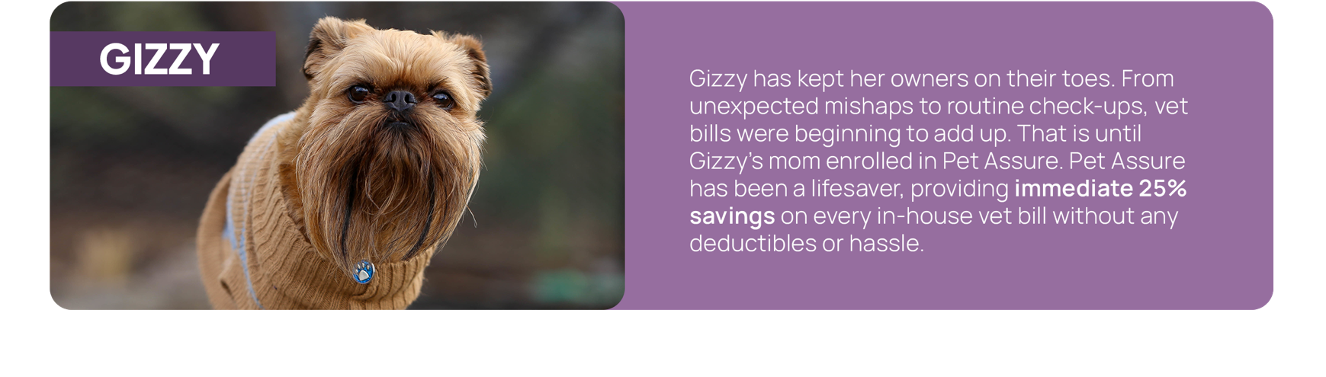

PET ASSURE
MAKES SAVING EASY
Pet Benefit Solutions | www.petbenefits.com

Slide 12

PETPLUS
Quality products for your pet. Savings for you.

Slide 13
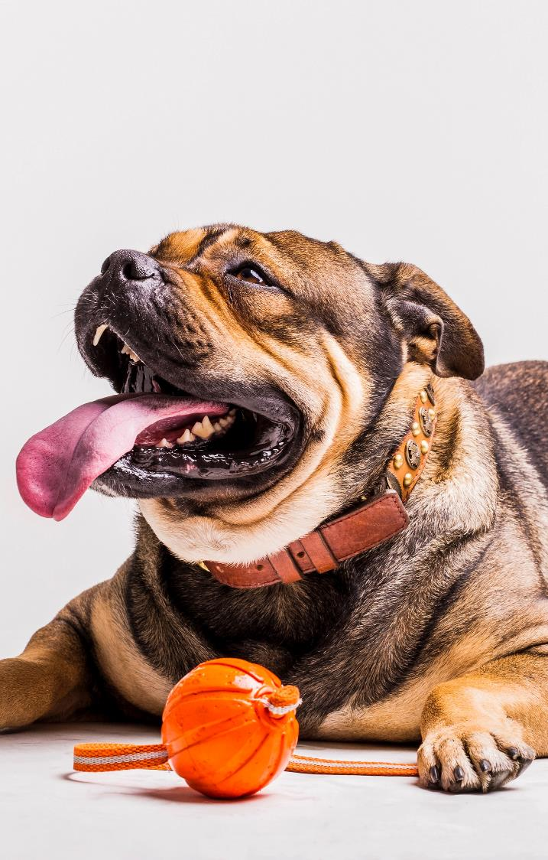

PETPLUS
PETPLUS
PET PRODUCT DISCOUNT PLAN
Receive members-only pricing (up to 40% off) on your pet’s prescriptions, preventatives, food, treats, and more
Shipping is always free
Most prescriptions can be picked up at participating pharmacies, including CVS, Walmart, and other independent CVS Caremark® pharmacies
All dogs and cats are eligible, regardless of age, breed, or health
Pet Benefit Solutions | www.petbenefits.com

Slide 14

HOW IT WORKS
PETPLUS
Shop Online
Shop for your pet’s favorite products at PetCareRx.com
Savings are automatically applied at checkout and shipping is always free
PetPlus will confirm prescriptions with your vet on your behalf
Pick-up In Store
Ask your vet for a written prescription for your pet’s medication
Present your pet’s prescription and PetPlus Rx card at any network pharmacy
The pharmacist will fill your pet’s prescription and PetPlus will charge your credit card on file at the listed member rate

Slide 15
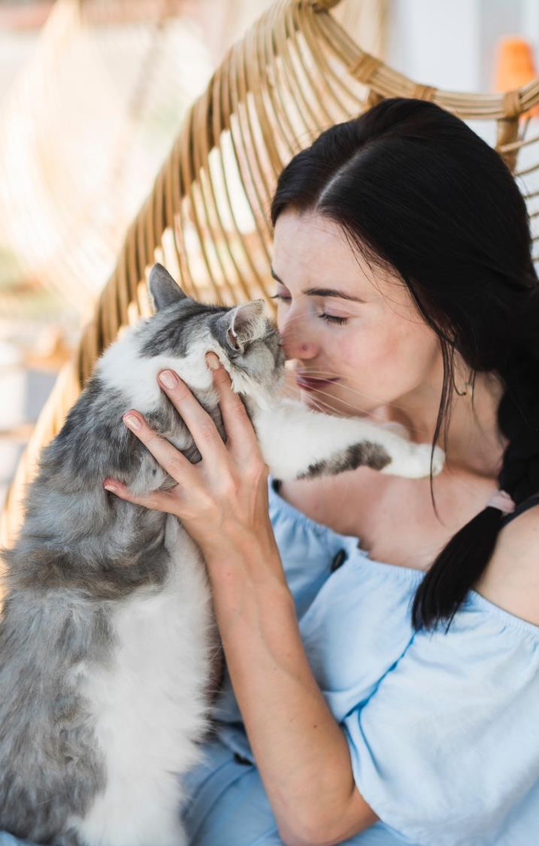

24/7 PET
TELEHEALTH
PETPLUS
Included with every PetPlus membership
Connect with a vet 24 hours a day
Staffed exclusively by licensed veterinarians
Receive answers to urgent questions about your pet’s health, wellness, behavior and more
Reduces unnecessary vet visits
No out-of-pocket costs or extra fees
Pet Benefit Solutions | www.petbenefits.com

Slide 16
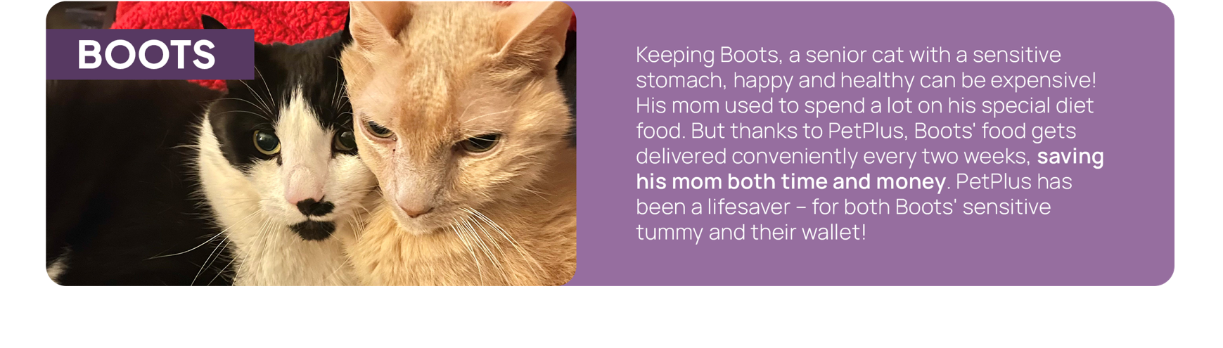
ENJOY BIG SAVINGS
WITH PETPLUS
Pet Benefit Solutions | www.petbenefits.com

Slide 17


ENROLL IN
PET BENEFITS TODAY!
Discounts on
veterinary care
Discounts on food,
prescriptions, & more
Questions? Contact Us
customercare@petbenefits.com | (800) 891-2565

